Slide 1
Black and racially minoritised Community and voluntary sector infrastructure Support
Brighton and Hove City Council

Slide 2
Introduction
BHCC has re-allocated £100,000 originally earmarked for a project called ‘The World Re-Imagined’ to support the development of the Black and racially minoritised (BRM) community and voluntary sector (CVS) in the city.
The report has reviewed the potential to invest this funding into the development of BRM CVS infrastructure provision
The finding are based on 22 semi structured interviews carried out with the leading BRM CVS organisations in the city.

Slide 3
Context
Key questions
What is meant by Black and racially minoritised organisations?
What is meant by Infrastructure support?
What are the concerns that highlighted the need for this report?

Slide 4
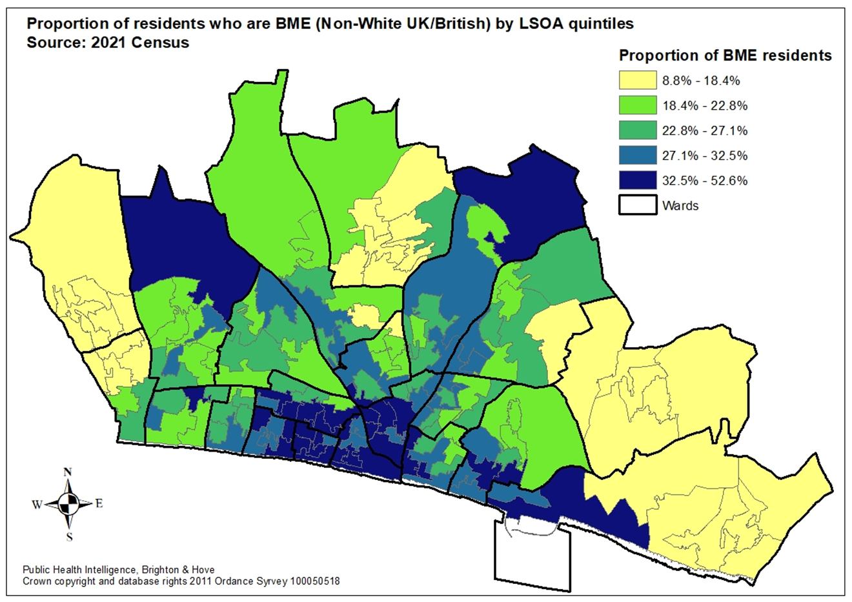
Some headline figures
2021 census data shows that:
72,272 people, 27% are from the ‘ethnic minority’ population (non-white UK/British). This is higher than the South-East (21%) but similar to England (27%).
The non-white population (previously referred to as BAME) in Brighton is 14.63% of the overall population.
13% have non-British nationality.
The BRM community is an established part of the City’s population.

Slide 5
Back drop to third sector funding
34% of beneficiaries of the 2021-22 Third Sector Commission came from BRM communities.
Only 2 BME CVS organisations were funded.
In 2020-21 15% of funding through the Communities Fund went to BRM organisations in 2021-22 17% of this funding went to BRM organisations
In 2020-2022, 17% of the COVID Outbreak Management Funds went to BRM CVS organisations
In 2020-2022, 21% of Winter and Summer School Holiday grants went to BRM CVS Organisations

Slide 6
Infrastructure support organisations in the city
Community Works
Trust for Developing Communities
Resource Centre
Hangleton and Knoll Project

Slide 7
Key findings (1)
Overwhelming sense across those engaged, including both the City’s established infrastructure bodies, that the BRM third sector needed to be better supported in enabling its future success
BRM CVS organisations felt there was a genuine need for separate BRM infrastructure resources
Strong support for an organisation that could provide dedicated BRM CVS infrastructure support
BRM interviewees asserted that the organisation needed to be ‘Black led’.
View that white-led organisations do/could not understand the cultural nuances required to implement the relevant and necessary support to BRM CVS organisations
The BRM CVS is not ready to deliver comparable levels of infrastructure support
No short-term fix, the BRM CVS would need support in a planned way over a longer time span
BRM CVS would need to work with other organisations, potentially not Black-led, to utilise their capacity to take the agenda forward.

Slide 8
Key Findings (2)
Infrastructure support needs include, organisational governance, policy, financial management, fund raising, IT, information governance and data protection, operational management, standard operational procedures, selection and recruitment, HR for staff and volunteers, and training.
Potential to galvanise the BRM communities and achieve a BRM CVS which is collectively greater than the sum of its parts
BRM organisations to be successful need to be equipped to compete in a competitive environment
There were few organisations from the BRM CVS which were able to take on this mantle
The BRM CVS want to come together to build a consensus for a way forward and to agree how best to establish the best structure for the delivery of infrastructure support.
Organisationally there was a perception that a shared vision and a collective work plan is needed
Existing infrastructure support organisations felt that the presence of a ‘Black led’ organisation doing this work was not an excuse to diminish their commitment to becoming anti racist organisations
Critical need for a shared vision for the BRM CVS

Slide 9
Options appraisal for available finding
Option 1
Do nothing
Option 2
Grant aid the BRM CVS
Option 3
Find single org to deliver BRM CVS infrastructure support
Option 4
Work with consortium of BRM CVS to deliver provision
The research did not see this approach as being of any real and sustainable value to the BRM CVS and collectively this was viewed as a waste of resource.
Decision not to proceed with this option
There was little support for this approach by those engaged in this research.
Respondents felt that this money would have little lasting impact on the BRM CVS
Decision not to proceed with this option
There was little support for this approach by those engaged in this research.
Respondents felt that there were few organisations well placed to take up this responsibility and that a partnership approach was preferable.
Decision not to proceed with this option
Strong willingness from the majority of those engaged in this research to take an approach
To build an alliance of BRM CVS organisation, in particular those that are ‘Black led’ and committed anti racists
Work would be needed to bring these orgainsation to work collectively
Recommendation to take this option forward

Slide 10
Actions (1)
Short Term Actions
Deliver community leadership workshops independently facilitated to:
Agree a vision for the BRM CVS
Agree terms of reference of a ‘Consortium’ of BRM CVS Organisations
Agree a modus operandi for the ‘Consortium.’
Agree an initial work programme for the ‘Consortium.’
Agree approaches to the working relationships with the mainstream infrastructure organisation in the city, including the utilisation of their skills and services.
Agree host organisation to take on any selection and recruitment and employment responsibilities.
Agree the representative role the ‘Consortium’ could play and how it would play this on behalf of the BRM CVS in the city.
Present these agreements to the council and the CAG.

Slide 11
Actions (2)
Medium term actions (Years 2-3)
Recruit and employ staff to take on the agreed work of the ‘Consortium.’
Engagement with the wider BRM CVS to understand and audit their support needs.
Deliver against these needs either directly if capacity and capability is available or to refer these organisations to the mainstream infrastructure bodies in the city.
To develop specific work programmes including those relating to Governance, finance and fund raising, administrative support,
Longer term actions (Years 4-5)
Build capacity of the ‘Consortium’ to address a wider scope of infrastructure skills and capabilities.
Build capacity to grow the ‘Consortium’ to incorporate external funding from funders both within the city and wider.

Slide 12
Next Steps
Subject to CAG agreement to:
Invest C £2,000 on 3 facilitated workshops
Set aside budget of between £25,000 and £35,000 for 2023-24 to support the development of the consortium.

